Slide 1
GEOG 392/676 GIS Programing Lab
Zhenlei Song, Ph.D Student
Department of Geography
Email: songzl@tamu.edu
Office: CSA 301F

Slide 2
About Me
Zhenlei Song, Ph.D. Student, Dept. of Geography
Office Hours: Friday, 02:00PM – 05:00PM
Office Location: CSA 301F
Email: songzl@tamu.edu
Personal Website: https://szl-blog.netlify.app/

Slide 3
Lab Objectives
Environment Setting Up: VS Code, Git, Github
Python Basic Syntax
Familiar with/Proficiency in Python/arcpy
Conduct your work/project in ArcGIS Pro using Python related tools

Slide 4
Policies
Please follow directions!
We use CANVAS for the course. https://canvas.tamu.edu/
Lab submission in Canvas!
Do not leave lab submission blank!
Use correct formats for lab submission. (not just .txt file)
Please include results after running your codes (screenshots)
Late labs will be assigned a 10% penalty for each day it is late; deductions will accrue for late labs until 50% of the possible points for a given lab remain.
GitHub repo for course & lab contents:
https://github.com/TAMUCIDI/GEOG-392-GIS-Programming
You also need to use your own TAMU GitHub account to manage your codes

Slide 5
Academic Integrity
Aggie Honor Code
“An Aggie does not lie, cheat or steal, or tolerate those who do”
Guidance
Labs & homework are considered as individual work.
Collaboration is encouraged, but entirely copying is not.
About GenAI (ChatGPT), depends on “who is the tool”.

Slide 6
Lab 1 Tasks
Github Repo Setup
Tools
Local Env Setup

Slide 7
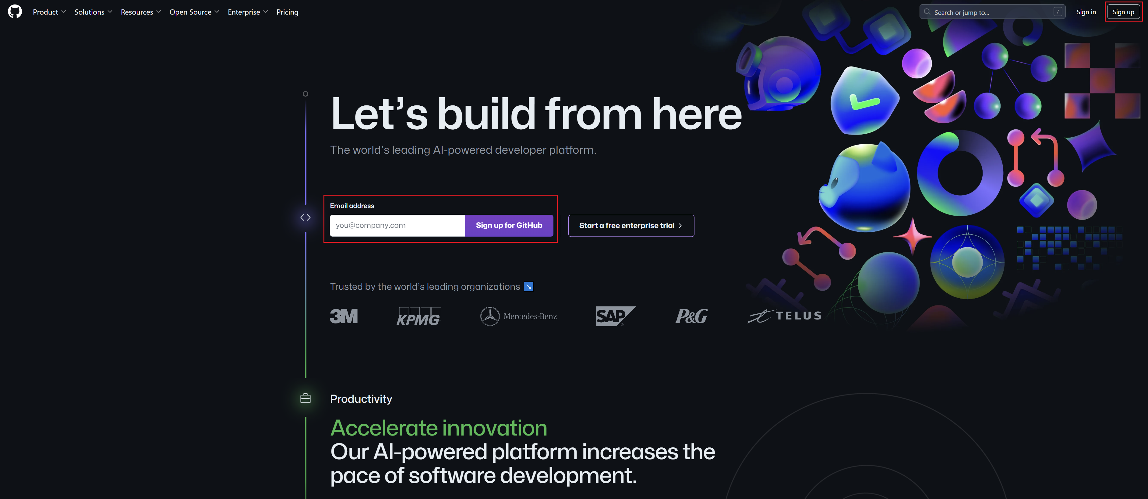
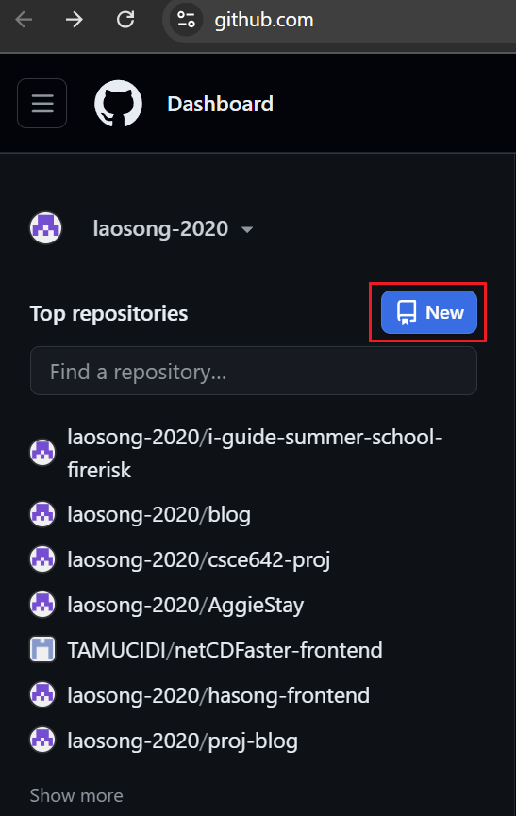
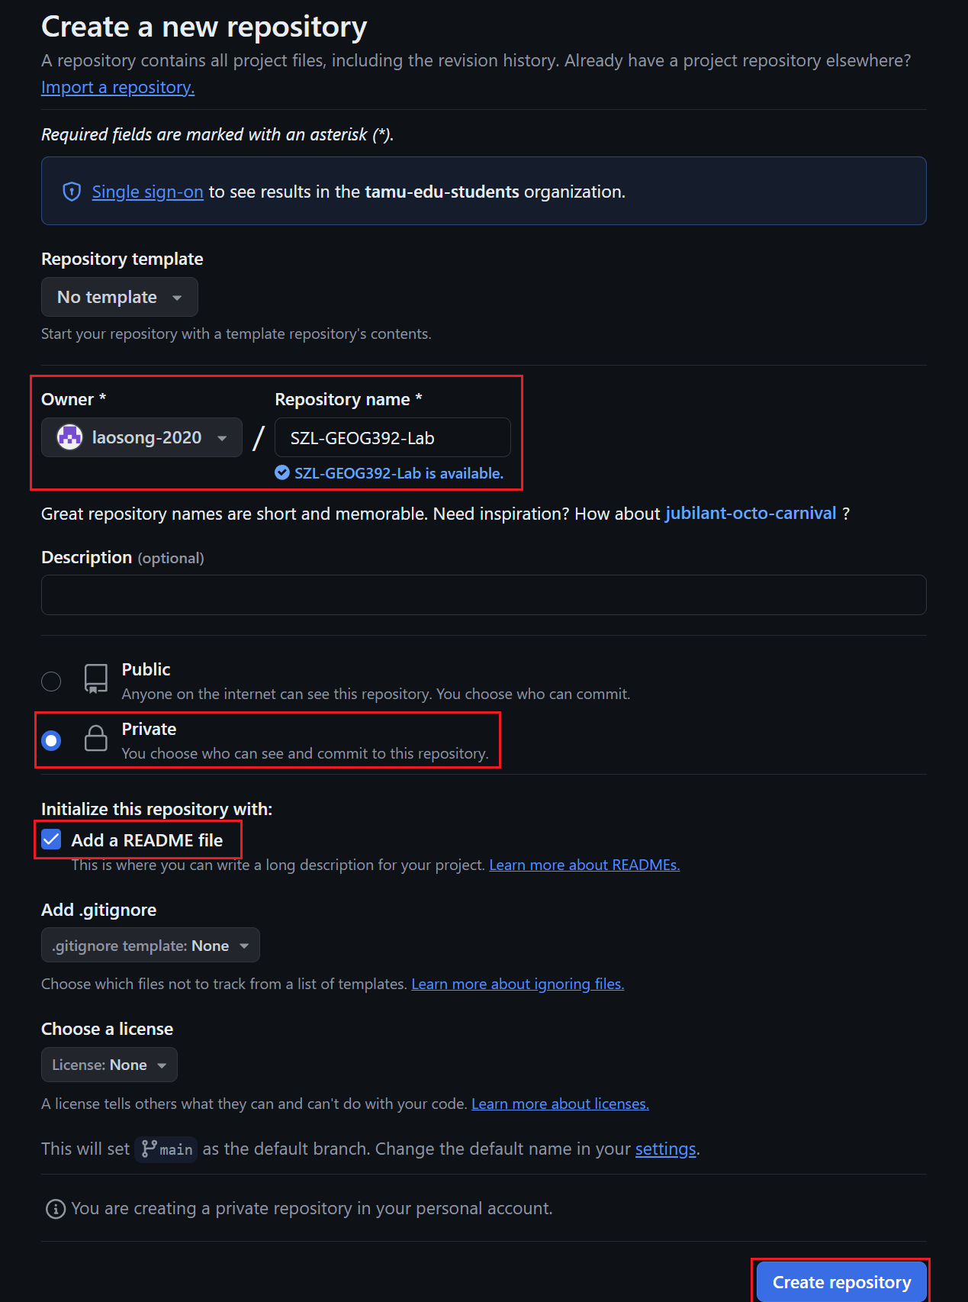
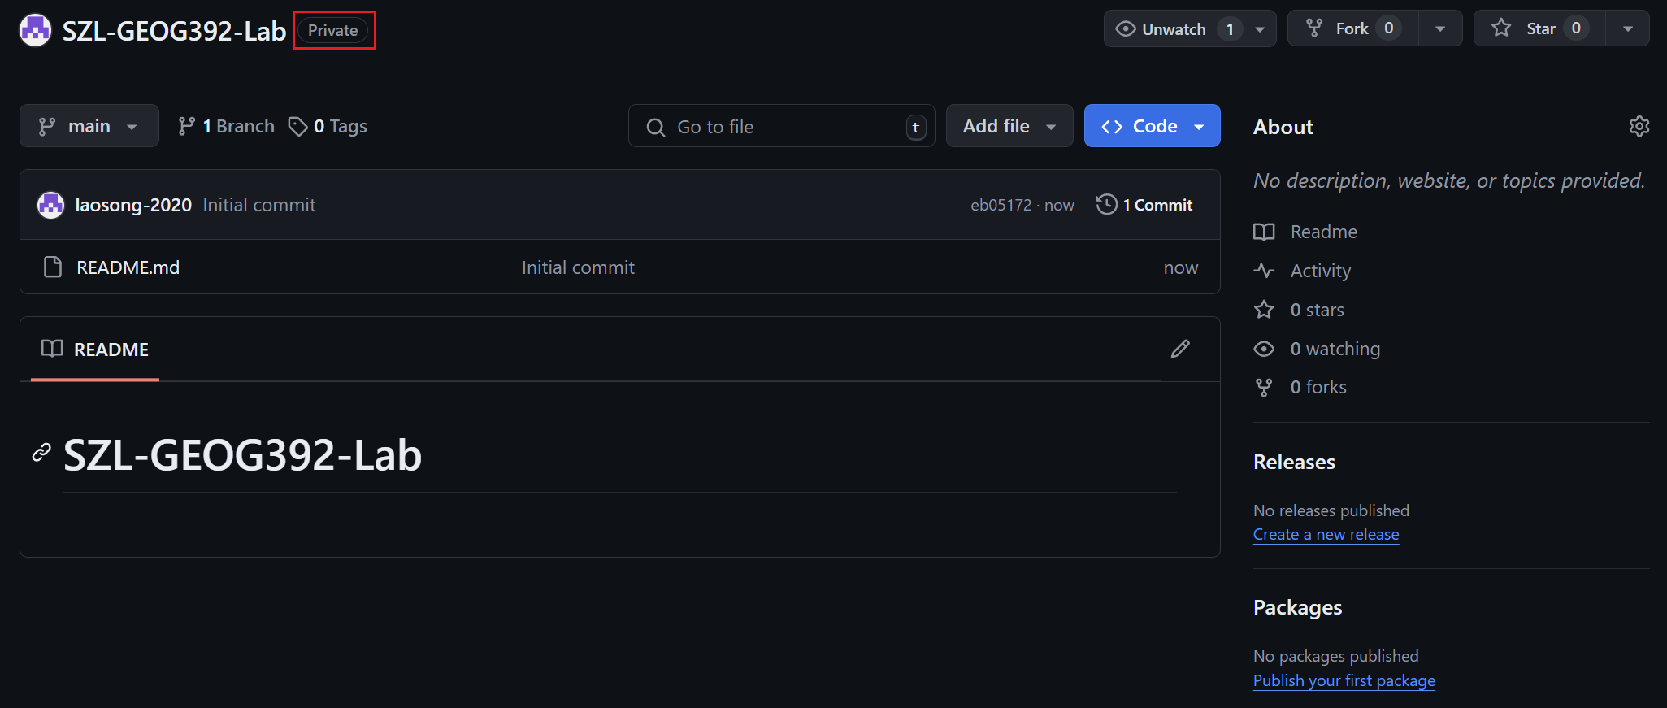
Github Repo Setup
Create a Github account if you haven’t.
Create a private repo for this course. Name it as “<your-initial>-GEOG392-Lab”

Slide 8
Tools
Git
Download link: https://git-scm.com/downloads
VSCode
Download link: https://code.visualstudio.com/download
Python
Download link: https://www.python.org/downloads/release/python-31011/
Why 3.10.11?

Slide 9
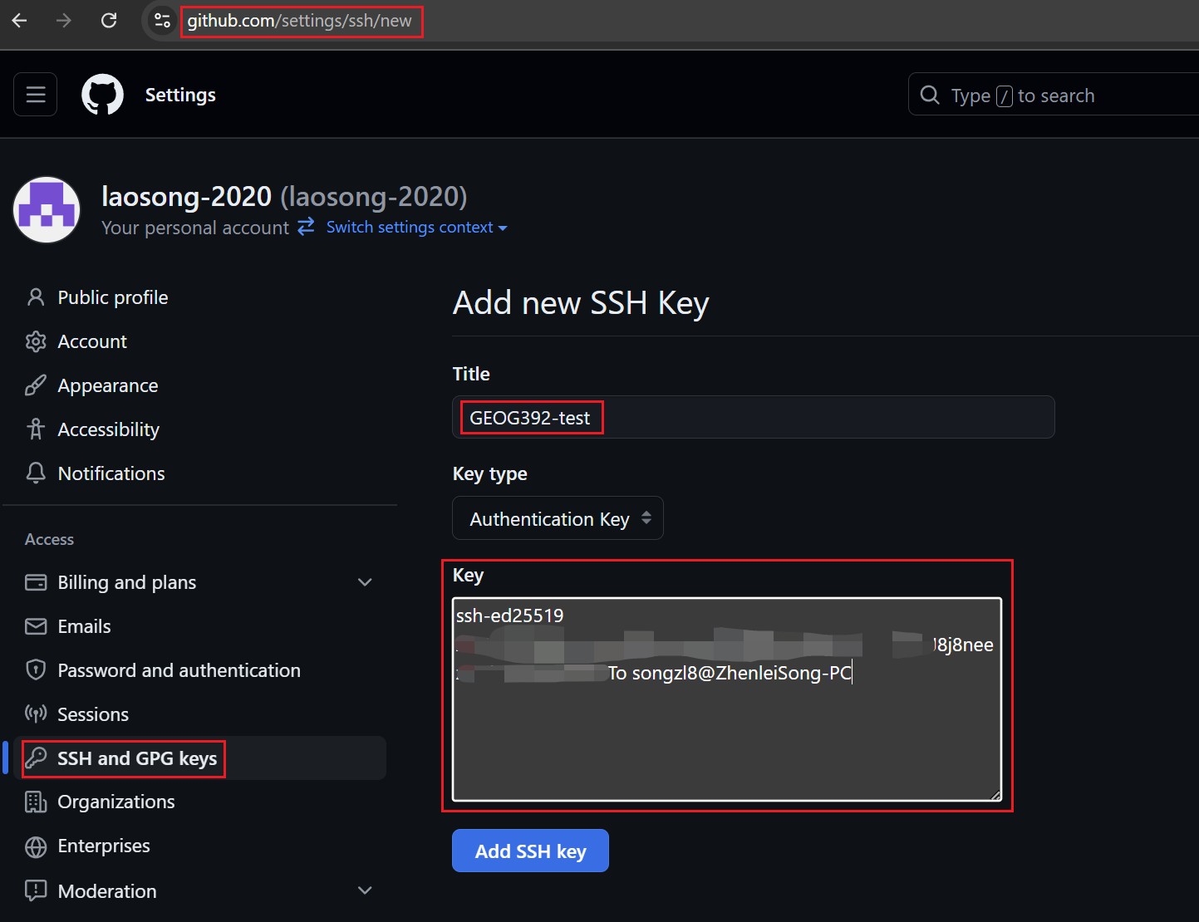
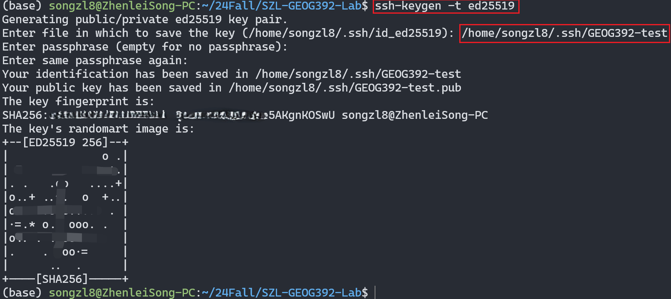
Local Env Setup
SSH Key Setting

Slide 10
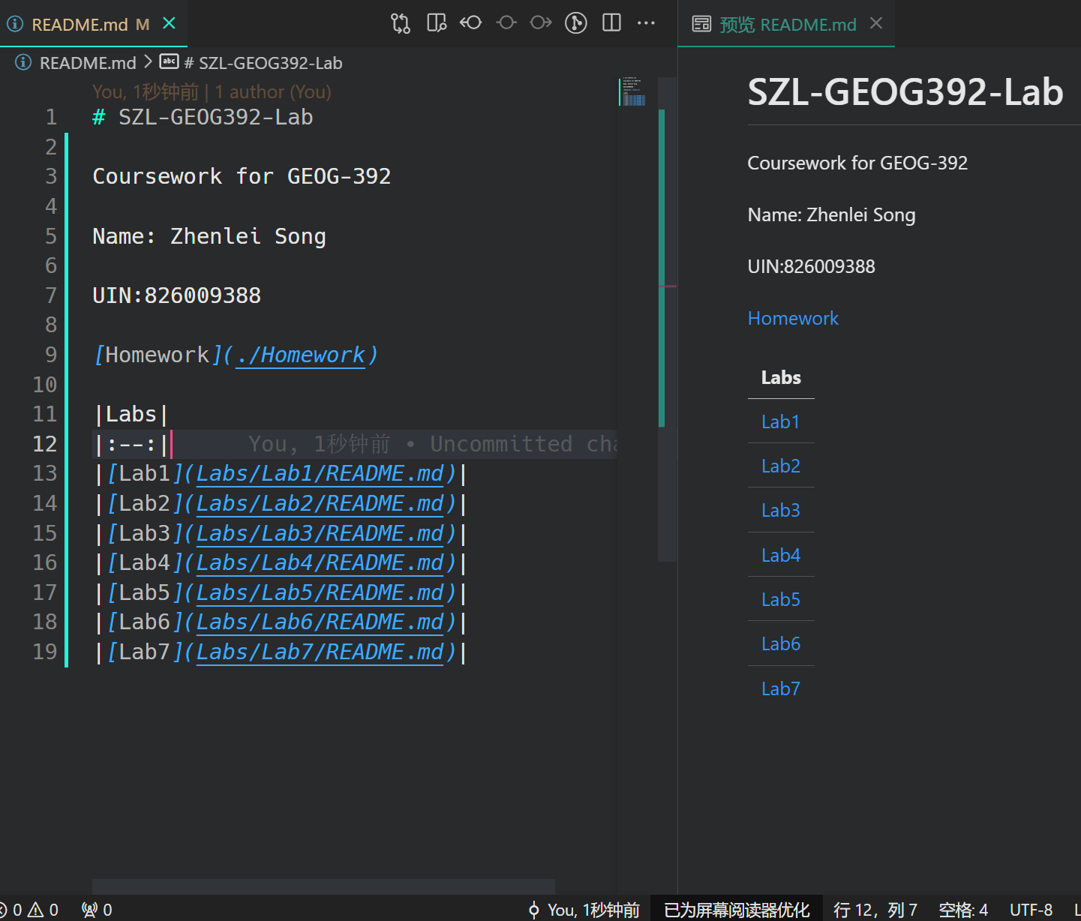
Local Env Setup
Add Folders & Files
Create `labs`, `projects`, `homeworks` folders
Add a table in `README.md` to insert link to folders
Git commit & push (optional)
`git add *`
`git commit –m “Edited the README.md”`
`git push origin main`

Slide 11
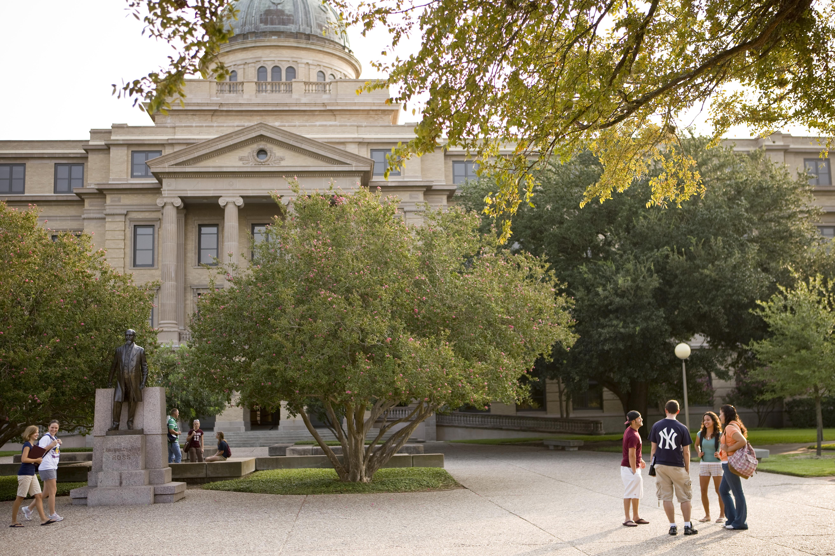
Other materials
Useful Links
MIT Missing Semester
Git/Github hands on demo
sshkey tutorial by Microsoft
GitHub student developer pack
VS Code Plugins
Python
Pylance
Python Debugger
Gitlens

Slide 12
The End

